Slide 1



Physics-Informed Machine Learning Simulator for Wildfire Propagation
Simone Azeglio
M2L School
simone.azeglio@edu.unito.it
January 12, 2021

Slide 2
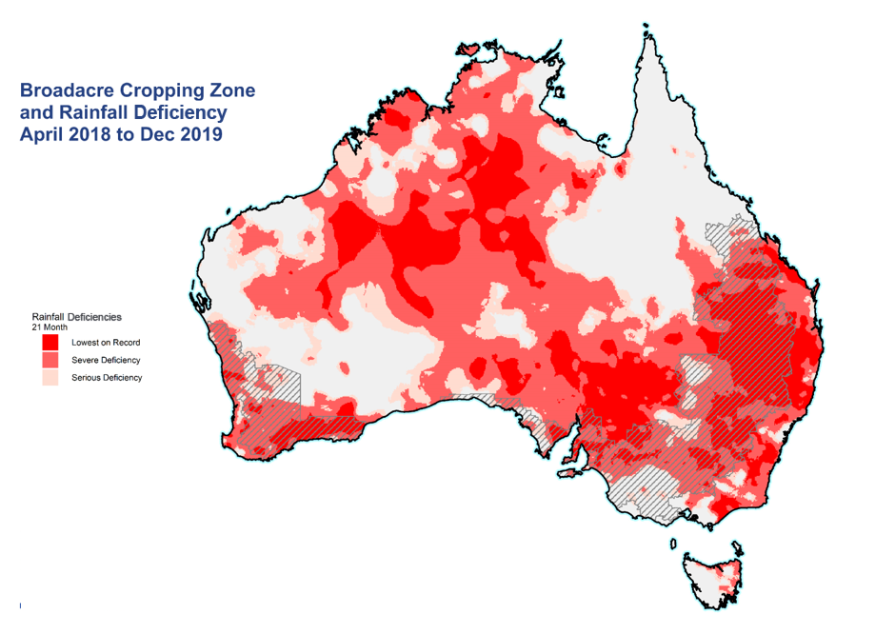



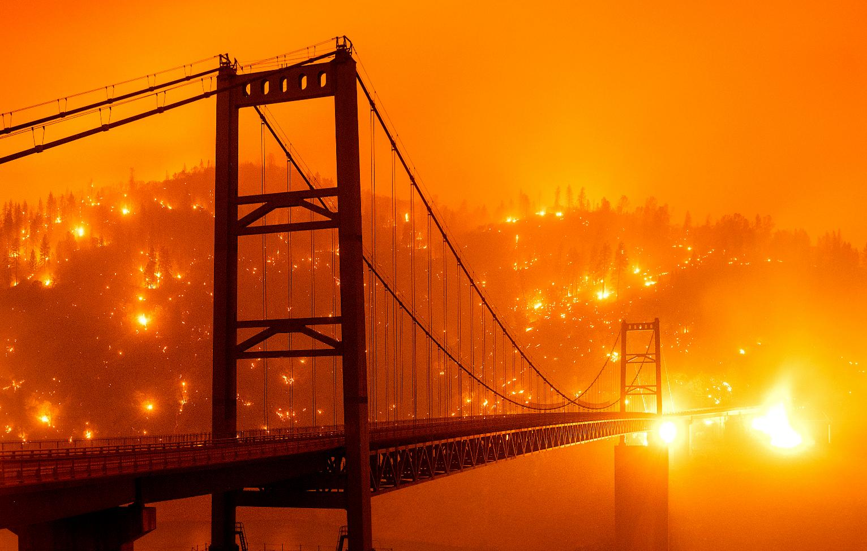
Wildfires Spread and Real-Time Simulations
Computational Physics state-of-the-art
Weather Research & Forecasting (WRF)
It takes hours for a single run
Scientific Machine Learning techniques:
Continuous solution (instead of discretized ones)
Evolution forecasting (out of domain)
Back-in-time reconstruction
M2L School
simone.azeglio@edu.unito.it
January 12, 2021
Notes:
Recently, wildfires have been increasingly growing in frequency and intensity, becoming a serious threat for living beings and socio-economic stability all over the world. Both Australia and California suffered from the most severe wildfire seasons recorded in modern history
So with this premise … What is our goal here?
In such worrisome scenarios, we’d like to have fast and accurate wildfire spread simulators that can run iteratively in order to evaluate several containment strategies.
The current state of the art, from computational physics is WRF is able to produce accurate predictions but… stop! … each simulation takes several hours, which is acceptable for a single run … but not for our needs.
In order to reach our goal, it is essential to increase the computational efficiency, which luckily, can be done thanks to SciML techniques: Here I listed 3 of the main advantages:
* the possibility to obtain a continous solution for the problem instead of a discretized one on a grid
* the possibility to forecast the evolution even outside the limits of the simulation domain
* the possibility to reconstruct the evolution back in time with applications to forensic analysis

Slide 3
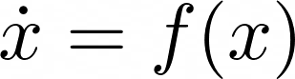

Physics-Based or ML?
Differential equations describe mechanisms and let the system evolve from this description
Machine learning models specify a learnable black box, which can be tuned with the right
parameters in order to fit any nonlinear function
Mix the two: add scientific structure to machine learning
Physics Informed Neural Networks (PINNs)
Curse of dimensionality?
P. Grohs et al., arXiv:1908.10828 [math.NA], (2019)
M2L School
simone.azeglio@edu.unito.it
January 12, 2021
Notes:
The major advances in machine learning were due to encoding more structure into some model, where “more structure” basically means faster and better fits from less data.
---- (Before SciML you might have seen this in CNN, the convolution operation basically takes a big square and finds a way to sum it into a smaller square … )
But what is the structure of science? You might ask... Heterogeneous Scientific data is encoded in the structure of scientific models
--- Instead of saying a "picture is worth a thousand words" we might say “a model is worth a thousand datasets”
There are two basic ways to define a model →
Differential equations describe mechanisms / structure and let the equations naturally evolve from this description (the rate at which x is growing depends on some function of x)
Machine Learning models specify a learnable black box, where with the right parameters you they can fit any nonlinear function
Which one is better? Neither ! Both have strengths and weaknesses (see appendix)
Let’s mix the two --> add scientific structure to machine learning
The result is “Physics Informed Neural Networks” , where instead of training the neural network directly on data, we employ (usually) a shallow feed-forward NN as an efficient approximator of trajectories in the solution space → This approach leads to numerous advantages, such as avoiding the curse of dimensionality
As the dimensionality of the problem increases, the computational costs of a numerical equations solver grows exponentially, while PINNs can be proven to have a polynomial bound … It’s a bunch of symbols, right ?
To me it looks like Egyptian Hieroglyphs…I guess That’s why we are glad that mathematicians who work on algorithmic complexity exist !
3

Slide 4
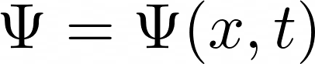
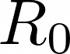
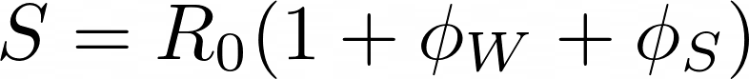
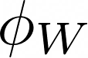
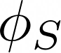
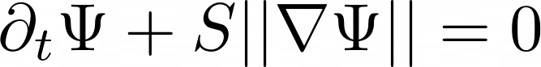
Some Maths behind Wildfires – Level Set Equation
Level Set Function
J.Mandel et al., Geoscientific Model Development (2011)
Burning Area
Fireline
Rothermel Formula (Spread Rate)
Spread rate in the absence of wind
Wind factor
Slope factor
Level-Set Equation
M2L School
simone.azeglio@edu.unito.it
January 12, 2021
Notes:
I’m not going for a complete tour of the WRF model for wildfires since it would involve a lot of math, ugly PDEs systems and stuff ….
But I’m just going to spend a few words on one PDE, the Level Set Equation which is the mathematical core of fire spread
In WRF, the propagation of a fire burning is implemented by the level-set method, which evolves a function \psi called «level set function»
Such that the burning are at time t is \Omega
And the fireline, which is the boundary of the burning region \Gamma(t)
The model adopts a semi-empirical approach, where the fire spread rate S is computed from fuel (basically the ground is made up of different chemical compounds, fuels) properties, using the Rothermel formula
Where R_0 represents the spread rate in the absence of wind, \phi_W is the wind factor and \phi_S the slope factor (which depends on the ground morphology)
(Last ingredient: on the fireline the tangential component of the gradient \grad \Phi = 0, meaning that the fire propagation speed is normal to the fireline \Gamma)
Now we are ready to write down the Level-Set Equation .. Here you are … in WRF this is solved numerically by a second-order Runge-Kutta method

Slide 5
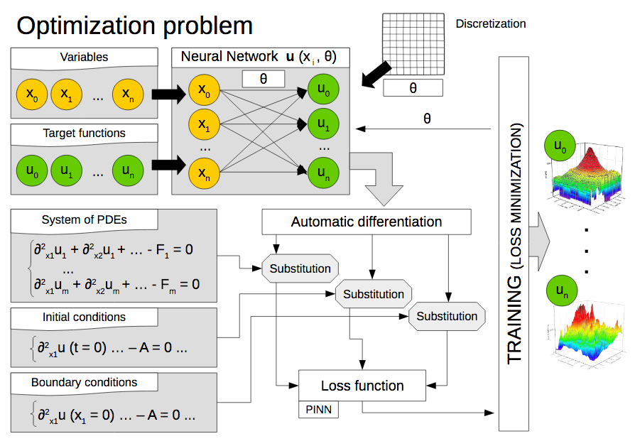


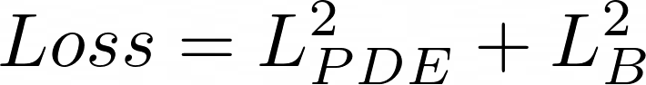
A Novel PINN Architecture
^
NeuralPDE.jl
DiffEqFlux.jl
C. Rackauckas et al., Journal of Open Research Software (2017)
m
m
C. Rackauckas et al., arXiv:2001.04385 [cs.LG], (2020)
Loss Function
m
M2L School
simone.azeglio@edu.unito.it
January 12, 2021
Notes:
We have replaced the numerical solvers with a profoundly different approach, by employing the recently developed Julia packages NeuralPDE.jl and DiffEqFlux.jl which support Physics Informed Neural Networks.
The underlying architecture can be summarized by the following steps. Let’s put ourselves in the most general case, where we want to find m+1 target functions [u_0, …, u_m] which satisfy a system of n PDEs. We first construct a surrogate solution to u(x) as a neural network u_hat(x;\theta) with n inputs and outputs and parameters \theta; since a neural network is mathematically a composite function, the derivaties of u with respect to its input can be evaluated by applying the chain rule for differentiating compositions of functions using automatic differentiation (AD).
Then we need to define a loss function in order to calculate the discrepancy between u_s and the outputs of the neural network, this is where we force our network to satisfy the physics imposed by the PDEs.
The loss function is made up of two parts: the former minimizing the L^2 norm referred to the PDE definition and the latter minimizing the L^2 between the boundary condition and the solution evaluated at the boundary
The last step is to train the neural network….
It is straightforward that minimizing the loss function means solving the equations, since we are approximating our target functions with u_hat better and better
The key point is that it converts an integration problem into a mere minimization task and it does not need data to train, because it is trained on the PDEs themselves The resulting neural network form a new class of universal function approximators that naturally encodes any underlying physical laws as prior information

Slide 6
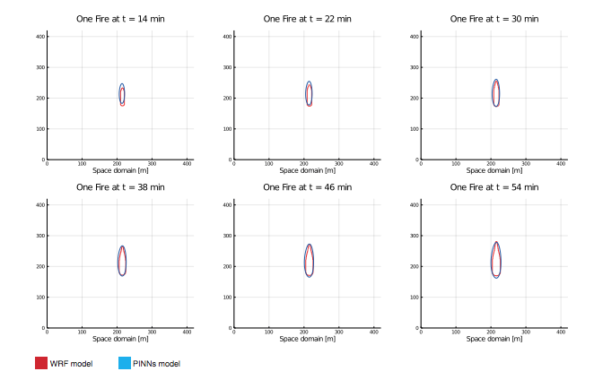
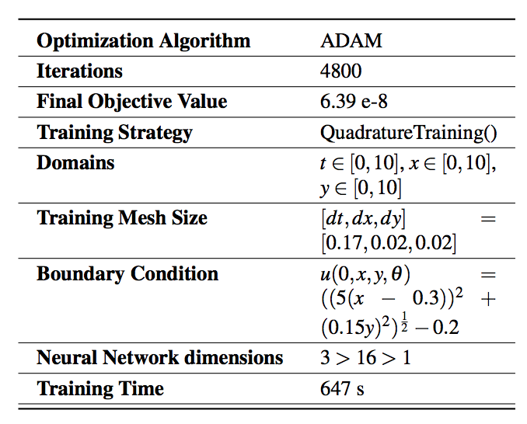
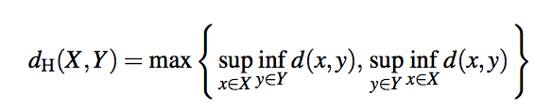
«One Fire» Simulation
Technical specs
Hausdorff Distance
M2L School
simone.azeglio@edu.unito.it
January 12, 2021
Notes:
It is a simple case, where we have only one ignition point, that demonstrates that our model works well in case of fires that spread in flat areas where the fuel doesn’t change. It also evolves according to the wind direction.
Here are some specs
We have been using ADAM as the optimization algorithm
AS you can see the final objective value is , it didn’t take long → around 11 minutes and nearly 5000 iterations
Time and spatial domains are all between 0 and 10
And the mesh size for training is finer for space
Initial condition is a cone with elliptical section
As you can see the neural net is shallow and the number of parameters is somewhat very small compared to the vast majority of cases where NNs are employed
Here you can see the results at different time frames
In order to provide a quantitative measure of the error between the outputs, we decided to use the Hausdorff distance (which has been further normalized on the burning area)

Slide 7
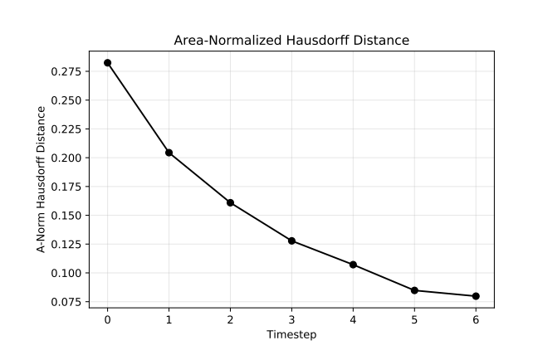
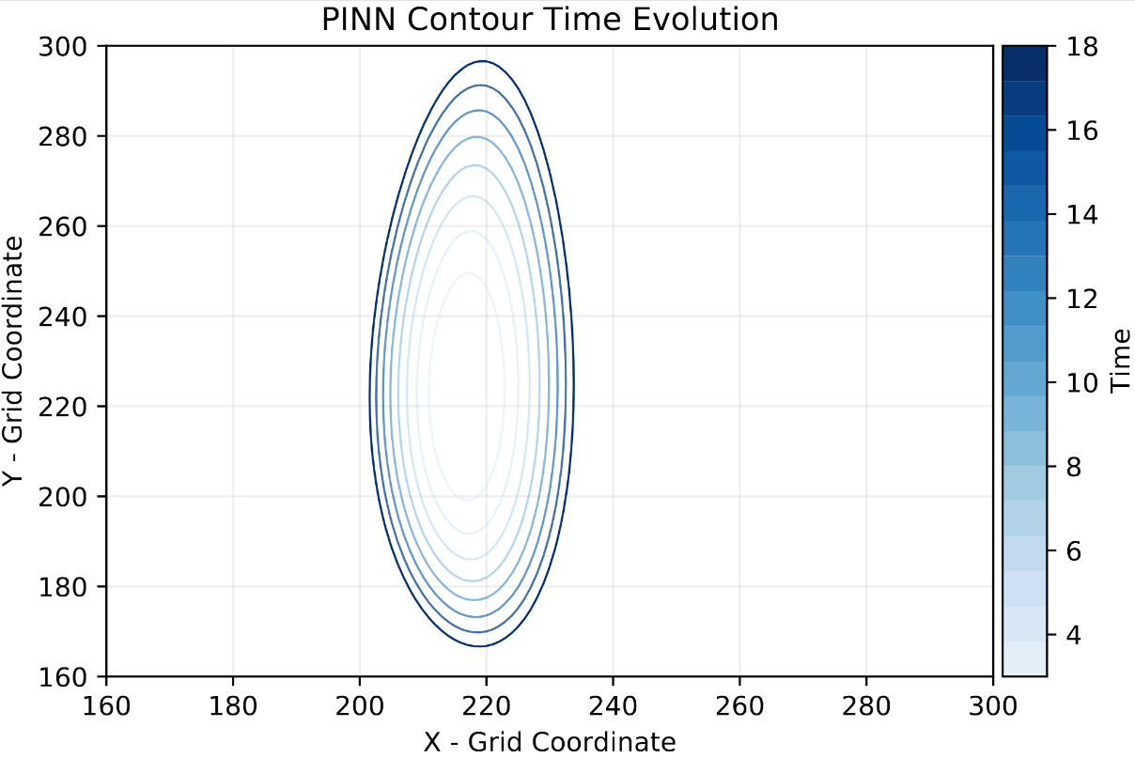
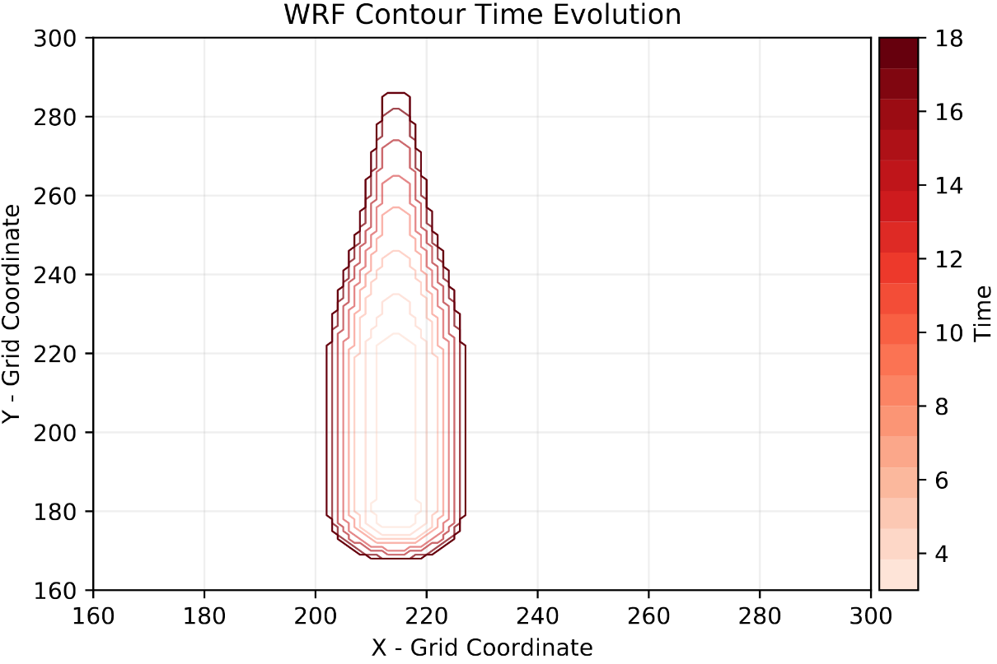
«One Fire» Simulation
M2L School
simone.azeglio@edu.unito.it
January 12, 2021
Notes:
The fact that the Hausdorff distance decreases, another confirmation is in the plot below, tells us that as the area grows with time, the difference between the two regions doesn’t increase, meaning that they evolve in synchrony and with the same shape
Here on the right, the contour time evolution : I don’t blame you if you’ve thought that WRF firelines look like wine-bottles. Well if you haven’t I guess you don’t have an Italian bias.

Slide 8

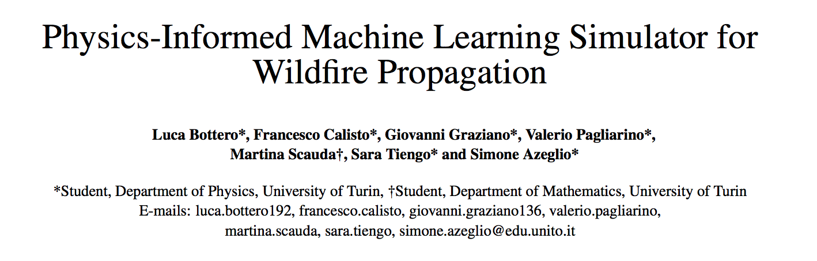




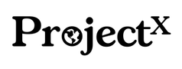
Conclusions
Advantages
Significant speed-up (Training time ~ 10 mins)
Neural Networks can extend the predicted solutions
outside of the training domain
Solution interpolation on a continuous mesh
Modifying equations is as easy as writing 2 lines of code
This architecture doesn’t need NNs with a large number of
dof
Less dof = More interpretability (wrt DNNs)
PINNs can be used to refine theoretical models
https://github.com/MachineLearningJournalClub
SciML
arXiv:2012.06825
M2L School
simone.azeglio@edu.unito.it
January 12, 2021
Notes:
In this last slide I’d like to briefly discuss about the main advantages of this techniques
We have gotten a rough estimate of the speed up our model provides , 10 mins against hours … This point has to be further analyzed, on one hand we used simple examples (in our paper we applied this method to the Isom Creek fire, which happened in Alaska in 2020), on the other hand we worked only with one Core (there are still improvements to be made on the library for parallel computing and gpu computing)
While numerical methods only work on the initial domain range, this architecture learns the NN parameters that can be used to extend the predicted solution outside of the training domains, this can be used for forensic investigations: it is possible to reconstruct the ignition point and the evolution of the fireline from the final state of the wildfire
It is possible to interpolate the solution on a continuous mesh
Modyfing the equations is as easy as changing a few lines of code, instead of re-implementing the discretizaition and perturbative form of the equations, allowing for faster investigation of new models
This architecture doesn’t need NNs with a high number of degrees of freedom to be accurate, reducing the overall computational cost and increasing performance. In quantitative terms it means not exceeding some tens of neurons on a single hidden layer
As a consequence, the model is more interpretable and users can run the resulting simulator on standard PC without needing high performance machines
PINNs can be used to extrapolate physical laws once they have been interpolated, hence providing a tool to refine theoretical models (data-driven model discovery, 4th paradigm of science)
8

Slide 9
Appendix – Why Differential Equations vs Why ML?
Differential equations are great
They understand the structure
They extrapolate far beyond data
They are interpretable
Differential equations are limiting
They require that you know the mechanism
ML models can give a predictive model directly from data
Universal Approximation Theorem
Neural Networks are fancy Taylor Series: good for computing, bad for analysis
Neural Networks overcome the “Curse of Dimensionality”
They work well in high dimensions
Pros of NN: They can approximate anything
Cons of NN: They can approximate anything!
M2L School
simone.azeglio@edu.unito.it
January 12, 2021

Slide 10
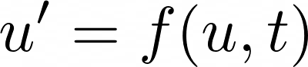
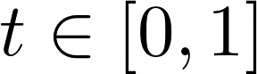
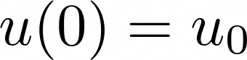
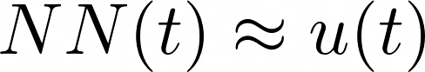
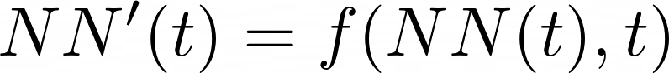
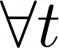
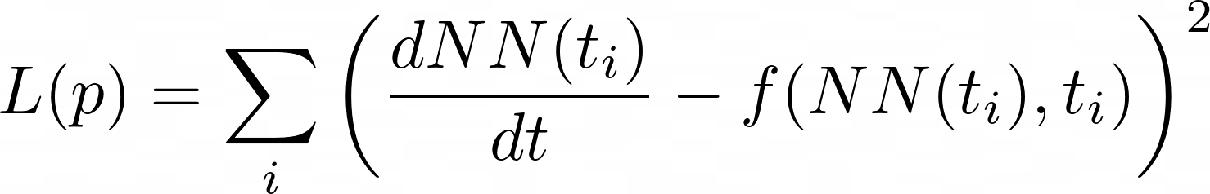
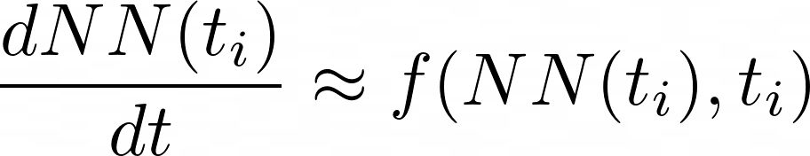
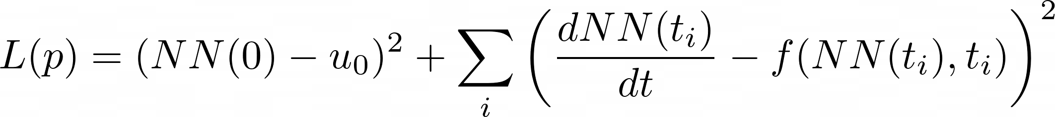
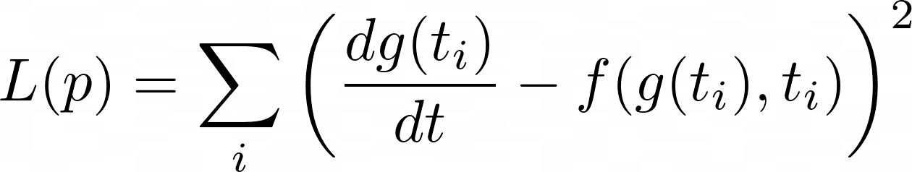
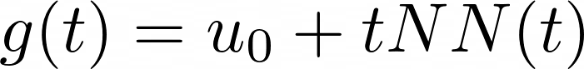
Appendix – Solving ODEs with Neural Networks
E.Lagaris et al., arXiv: physics/9705023 (1997)
System of ODEs
NN approximation
Loss Function
minimization
Handling initial condition
More efficiently
M2L School
simone.azeglio@edu.unito.it
January 12, 2021
Notes:
This is a result first due to Lagaris et. al from 1997. The idea is to solve differential equations using neural networks. How? by representing the solution by a neural network and training the resulting network to satisfy the conditions required by the differential equation.
Let’s say we want to solve a system of ordinary differential equations
u’= f(u,t) with t in [0,1] and a known initial condition u(0) = u_0. To solve this, we approximate the solution by a neural network:
NN(t) ~ u(t)
If NN(t) was the true solution, then it would hold that NN’(t) = f(NN(t),t) for all t. Thus, we turn this condition into our loss function. This motivates the loss function:
L(p) = sum….
The choice of t_i could be done in many ways: it can be random, it can be a grid, etc. Anyways, when this loss function is minimized (gradients computed with standard reverse-mode automatic differentiation), then we have that dNN(ti)dt≈f(NN(ti),ti) and thus NN(t) approximately solves the differential equation.
Note that we still have to handle the initial condition !! One simple way to do this is to add an initial condition term to the cost function. This would look like
L(p) …
While that would work, it can be more efficient to encode the initial condition into the function itself so that it's trivially satisfied for any possible set of parameters. For example, instead of directly using a neural network, we can use:
g(t) = u_0 + tNN(t)
As our solution. Notice that g(t) is thus a universal approximator for all continuous functions such that g(0)=0!!!!! (This is the prior information)
Since g(t) will always satisfy the initial condition, we can train g(t) to satisfy the derivative function, then it will automatically be a solution to the derivative function. In this sense, we can use the loss function
L(p) = sum_i
where p are the parameters that define gg, which in turn are the parameters which define the neural network NN that define g. Thus this reduces down, once again, to simply finding weights which minimize a loss function!

Slide 11
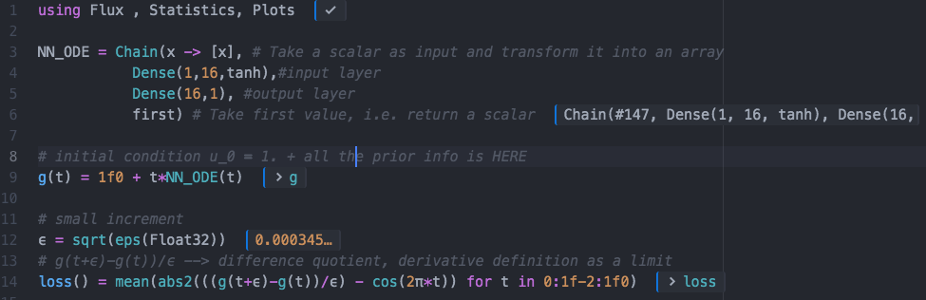
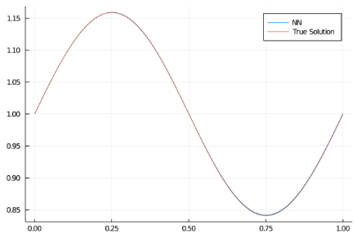
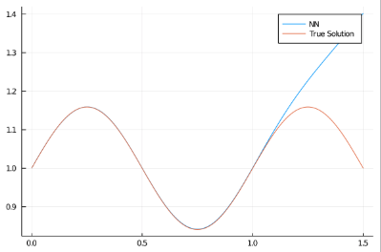
Appendix – Solving ODEs with Neural Networks
M2L School
simone.azeglio@edu.unito.it
January 12, 2021

Slide 12
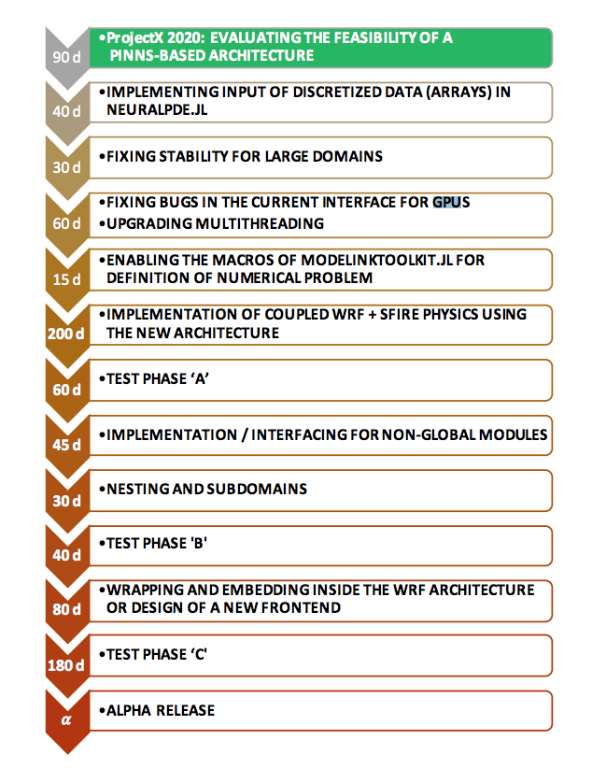
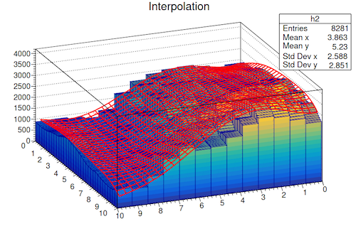
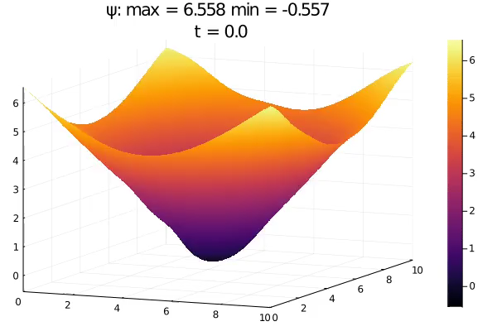
Appendix – Level Set Implementation
M2L School
simone.azeglio@edu.unito.it
January 12, 2021
Notes:
The level set equation, i.e. is a 2D surface embedded in a 3D euclidean space is initilially set as the distance of each point from the ignition line.
In our approach it is required that every quantity is provided either as a constant or as a function. Therefore we implemented the initial condition as a cone with elliptical section, because we had to deal with circular and linear ignition shapes
The algorithm contains all the necessary expressions for the calculation of the fire spread rate, taking into account the values of the wind, the altimetric profile, the fuel map etc etc ..
These variables should be given as differentiable vector fields of space and time, which can be considered both an advantage and a limit, on one hand the discretized measurements must be fitted using approximating functions, but on the other hand this method is very computationally efficient. As Future Work the possibility to give in input finite matrices of values is presented and mainly depends on the fact that some key libraries we are using are still under development.

Slide 13
Appendix - Limitations
Limitations
It can’t run on GPUs or multi-CPUs due to library limitations
Usage of a variable fuel map as a matrix is not yet supported
Stability analysis on discretization strategies and degree of freedom of the NN has to be made
How to deal with multiple ignition points?!
The technique hasn’t been extended on different architectures: CNNs, RNNs
Generalization capabilities aren’t still 100% clear
M2L School
simone.azeglio@edu.unito.it
January 12, 2021
Notes:
* It can’t run on GPUs or multi-CPUs due to library limitations, we’ve joined the sciml team from Julia computing in order to further develop it under Chris Rackauckas guidance
The library doesn’t support the use of matrices as functions of their indices. This means it is not possible to use a variable fuel map which turns out to be fundamental in order to capture the evolution of the fire with higher accuracy, there’s an open issue on github for that
Further stability analysis on discretization strategy and dof of the NN has to be made
We still have to figure out how to predict the spread of a wildfire with more than one ignition point

